Slide 1

Java Programming
Graphic User Interface

Slide 2
Outline
Create your 1st GUI program
Java GUI APIs
Java GUI programming
Containers & Components
JFrame/Jpanel/Jbutton/JLabel/JTextField/JTextArea/JScrollPane
Layout Managers
Event-Driven programming
Event source/Event trigger/Event listener/Event handling
Dialog
Menu

Slide 3
Creating your 1st GUI program

Slide 4
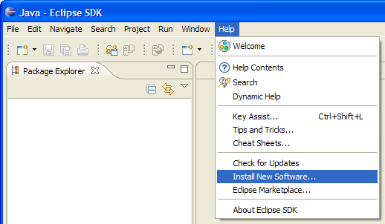
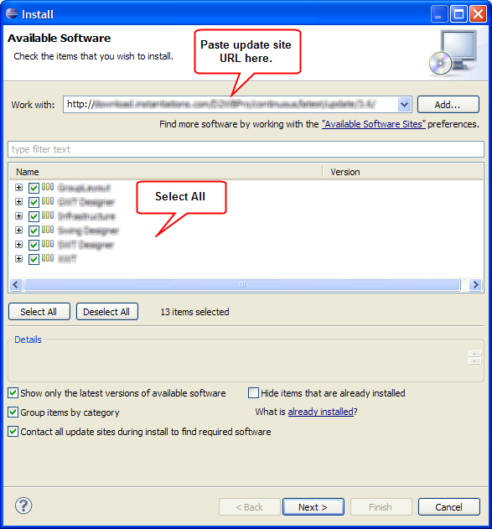
Installing windowbuilder
http://download.eclipse.org/windowbuilder/WB/integration/4.5/

Slide 5
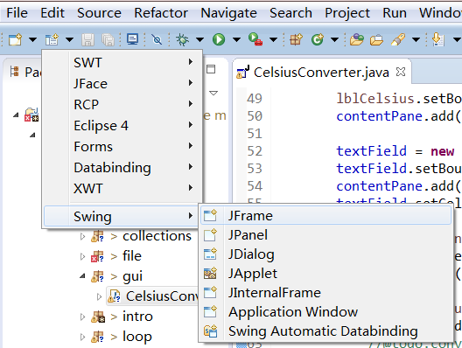
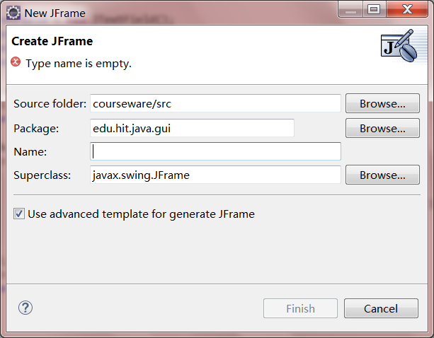
Creating 1st GUI Application

Slide 6
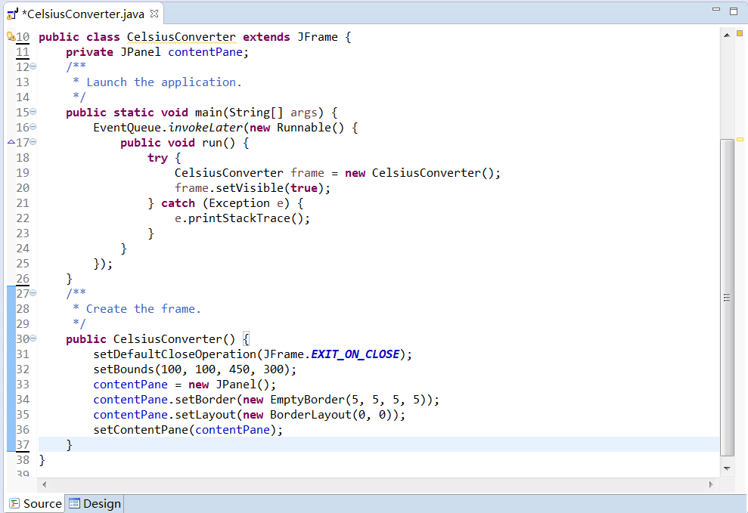
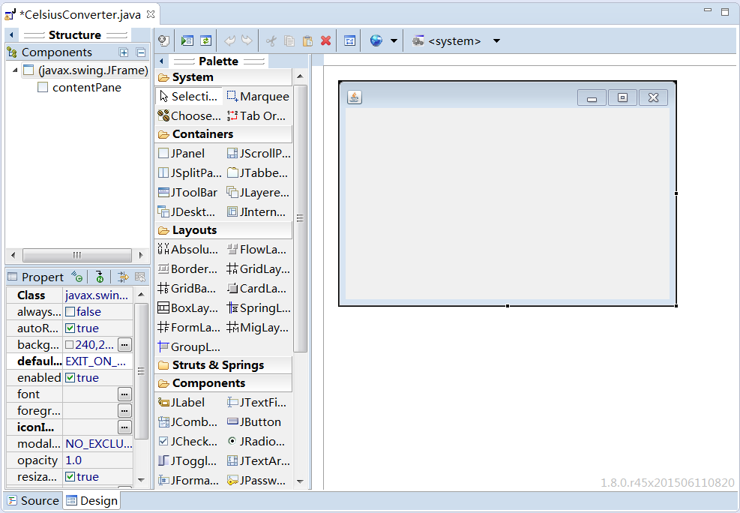
Code are generated automaticly

Slide 7
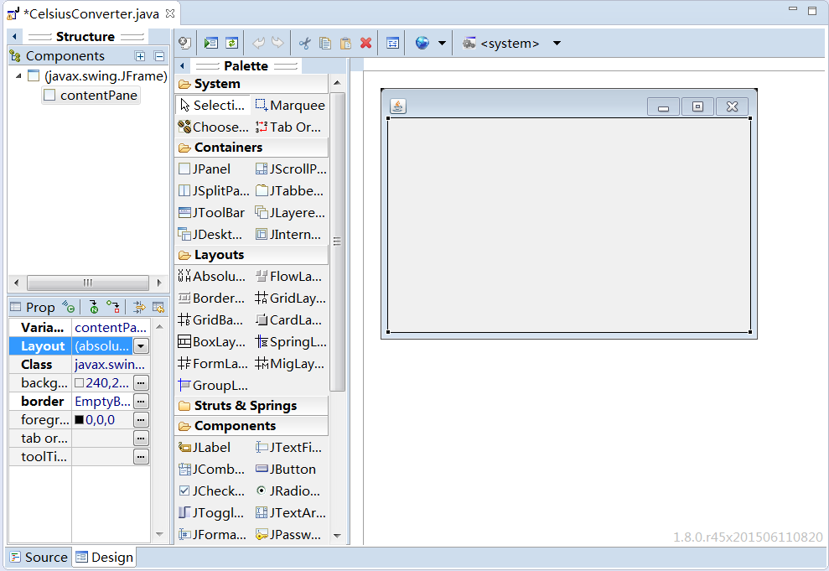
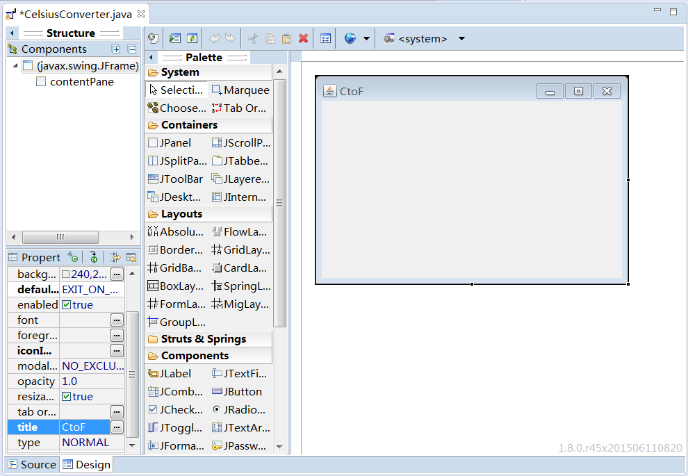
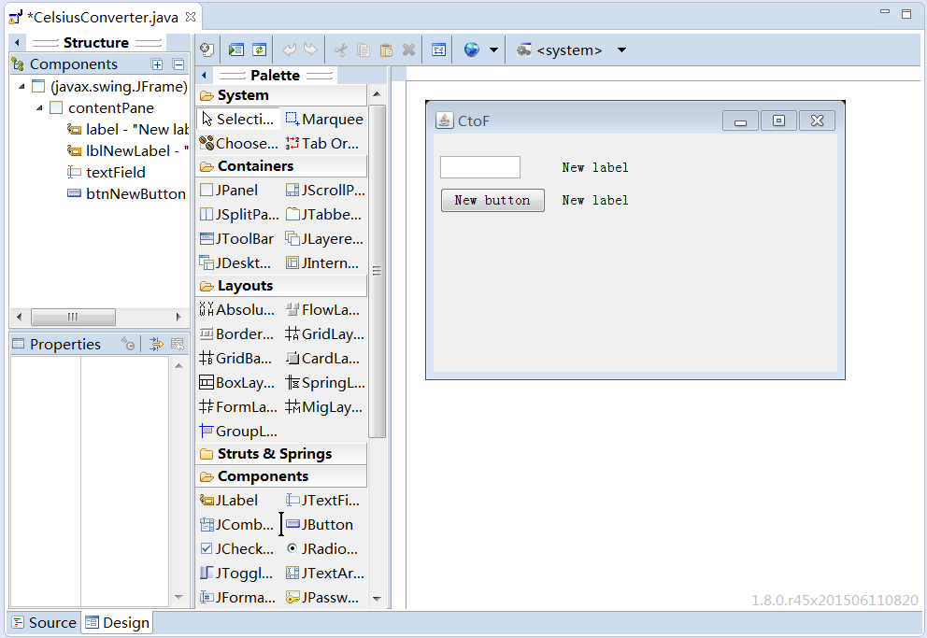
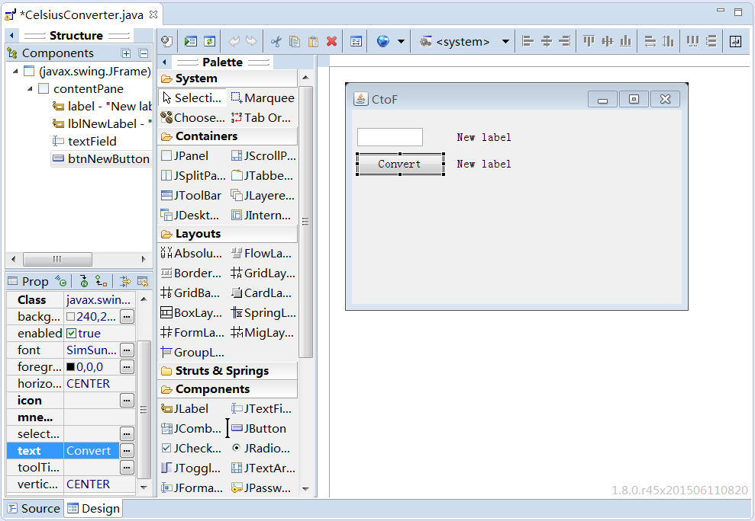
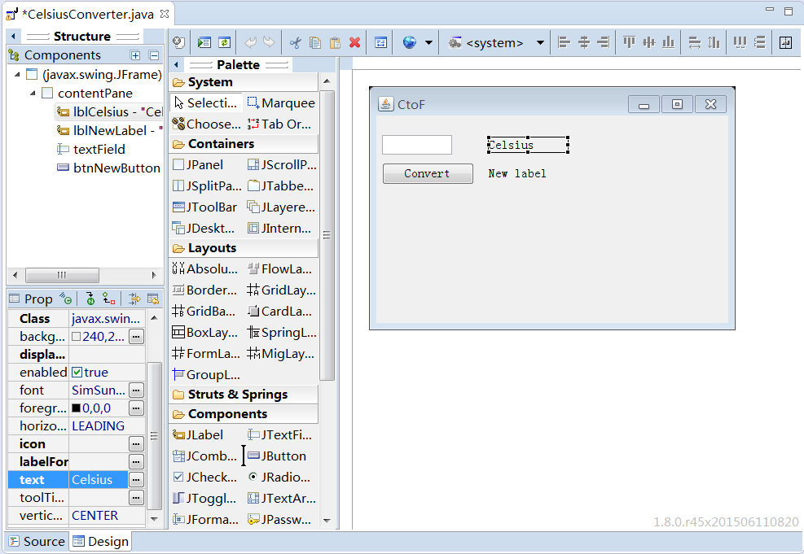

Designing GUI by WYSWYG editor

Slide 8
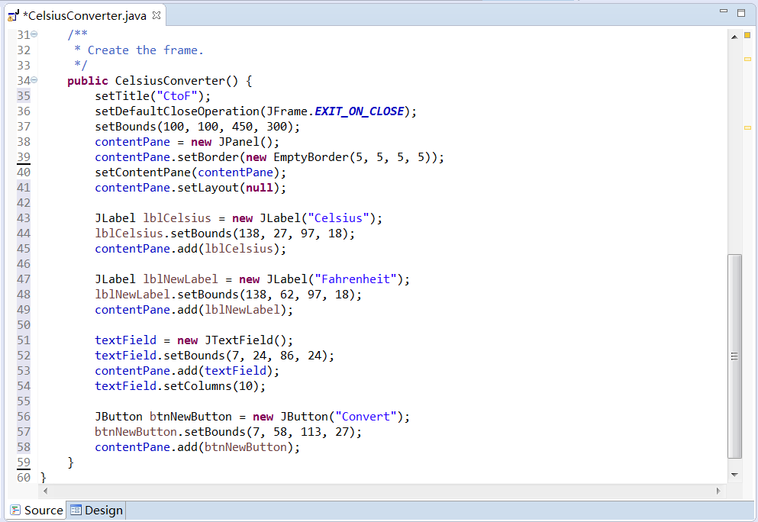
More code are generated

Slide 9
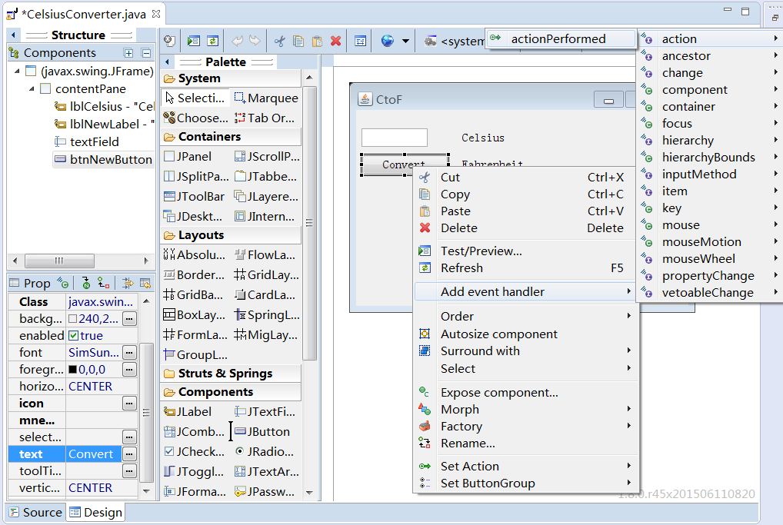
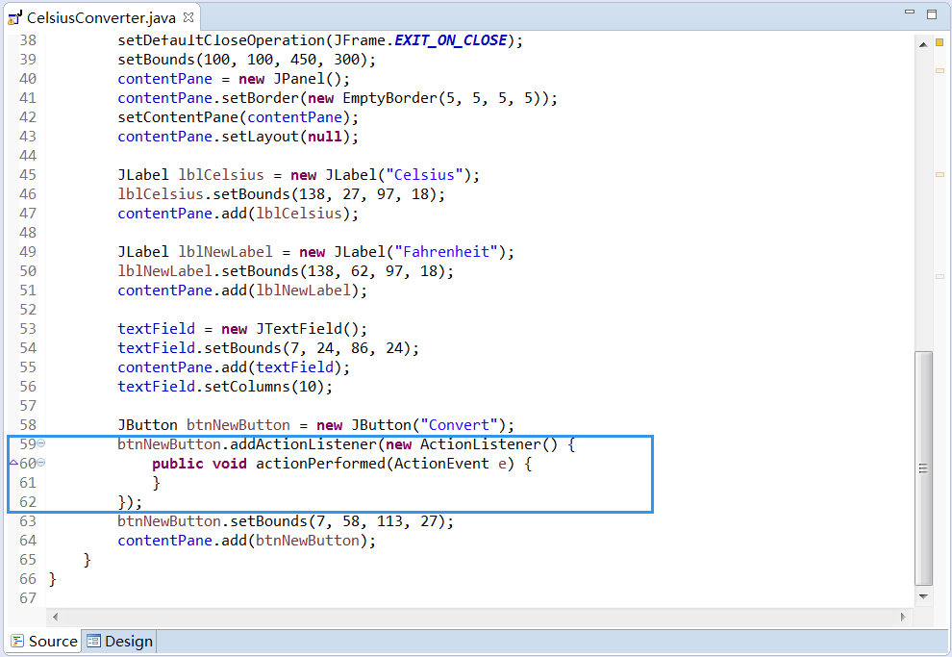
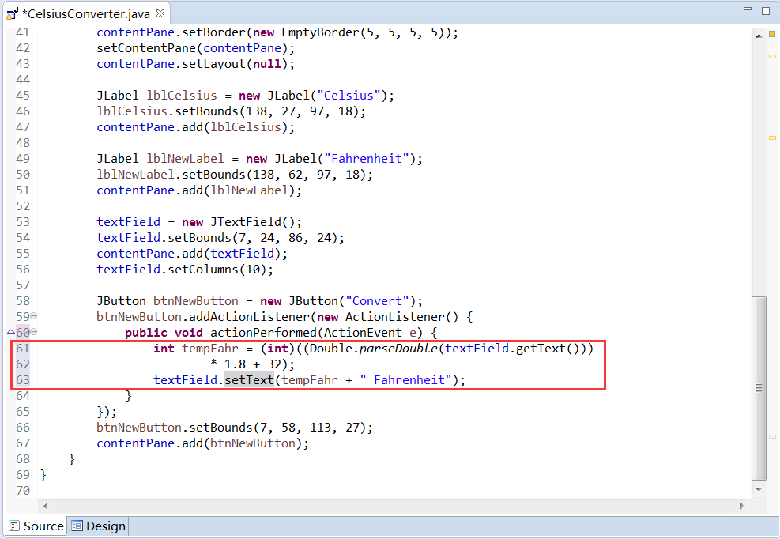
Write your own code

Slide 10
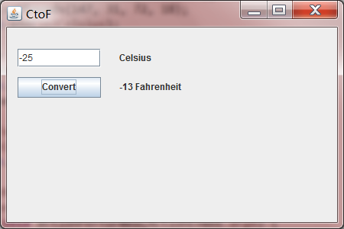
Run your 1st GUI application

Slide 11
Java GUI APIs
There are three sets of Java APIs for GUI programming:
AWT (Abstract Windowing Toolkit)
introduced in JDK 1.0.
have become obsolete and should be replaced by newer Swing components.
Swing
Swing is part of Java Foundation Classes (JFC) after the release of JDK 1.1.
Some legacy AWT classes (in package java.awt.event) are still used in Swing!
JavaFX
JavaFX is a set of graphics and media packages that enables developers to design, create, test, debug, and deploy rich client applications that operate consistently across diverse platforms.
Other GUI APIs that work with Java
SWT (Eclipse's Standard Widget Toolkit) (used in Eclipse),
GWT (Google Web Toolkit) (used in Android),
…

Slide 12
Swing
Swing is part of the so-called "Java Foundation Classes (JFC)" (have you heard of MFC?), which was introduced in 1997 after the release of JDK 1.1. JFC was subsequently included as an integral part of JDK since JDK 1.2. JFC consists of:
Swing API: for advanced graphical programming.
Accessibility API: provides assistive technology for the disabled.
Java 2D API: for high quality 2D graphics and images.
Pluggable look and feel supports.
Drag-and-drop support between Java and native applications.

Slide 13
Swing
Swing is huge (consists of 18 API packages as in JDK 1.7) and has great depth.
The main features of Swing are:
pure Java
Lightweight
pluggable look-and-feel
supports mouse-less operation
…

Slide 14
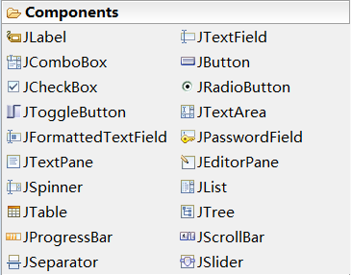
Components
Swing provides a huge and comprehensive collection of reusable GUI components.

Slide 15
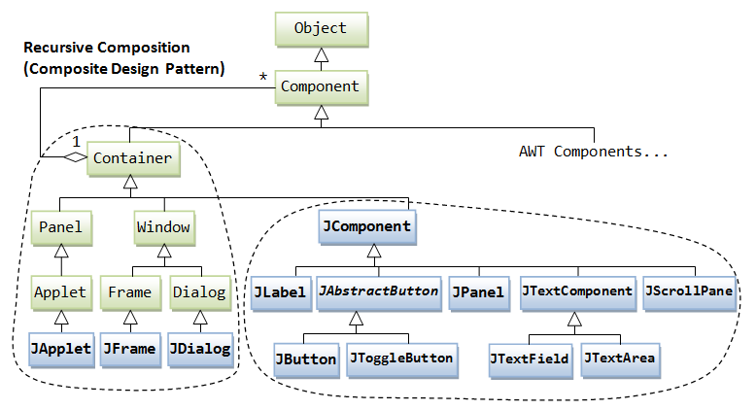
Containers
Besides the components, there are another group of classes: containers. A container is used to hold components. A container can also hold containers because it is a (subclass of) component.

Slide 16
Containers
Top-Level and Secondary Containers
Top-Level Containers
JFrame, used for the application's main window
JDialog: used for secondary pop-up window
JApplet: used for the applet's display-area
Secondary Containers (Content-Pane)
Jpanel: used to group and layout relevant components.
Note:
the JComponents shall not be added onto the top-level container!
The JComponents must be added onto the so-called content-pane of the top-level container!

Slide 17
Jframe & JPanel
A JFrame has a title bar (containing an icon, a title, and the minimize/maximize/close buttons), an optional menu bar and the content display area (also called content pane).
The content pane is a JPanel which is a rectangular area used to group related GUI components in a certain layout.

Slide 18
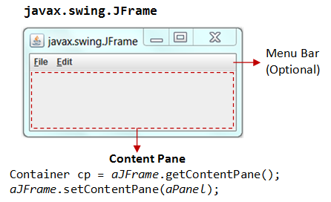
The content-pane
Two ways to get the content-pane
Get the content-pane via getContentPane() from a top-level container, and add components onto it.
If a component is added directly into a JFrame, it is added into the content-pane of JFrame instead
Create a JPanel and set it as the content-pane via JFrame's setContentPane().

Slide 19
Getting the content-pane
public class TestGetContentPane extends JFrame {
// Constructor
public TestGetContentPane() {
// Get the content-pane of this JFrame, which is a java.awt.Container
// All operations, such as setLayout() and add() operate on the content-pane
Container cp = this.getContentPane();
cp.setLayout(new FlowLayout());
cp.add(new JLabel("Hello, world!"));
cp.add(new JButton("Button"));
......
}
.......
}

Slide 20
Setting the content-pane
public class TestSetContentPane extends JFrame {
// Constructor
public TestSetContentPane() {
// The "main" JPanel holds all the GUI components
JPanel mainPanel = new JPanel(new FlowLayout());
mainPanel.add(new JLabel("Hello, world!"));
mainPanel.add(new JButton("Button"));
// cof this JFrame to the main JPanel
this.setContentPane(mainPanel);
......
}
.......
}

Slide 21

Layout Managers
A container has a so-called layout manager to arrange its components.
The layout managers provide a level of abstraction to map your user interface on all windowing systems, so that the layout can be platform-independent.
A container has a setLayout() method to set its layout manager.

Slide 22
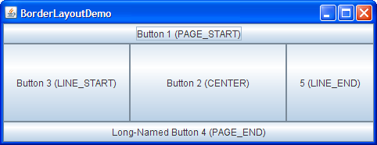
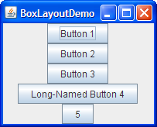
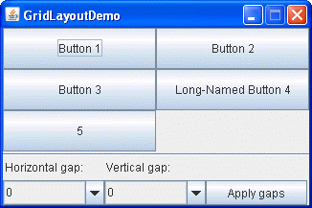
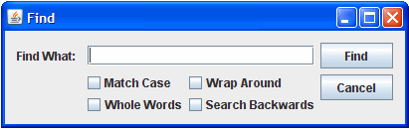
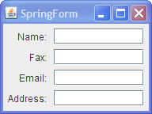

Some Layout Managers

Slide 23
FlowLayout
FlowLayout is the default layout manager for every JPanel.
It simply lays out components in a single row, starting a new row if its container is not sufficiently wide.
The row is, by default, centered horizontally within the container.
To specify that the row is to aligned either to the left or right, use a FlowLayout constructor that takes an alignment argument.
Another constructor of the FlowLayout class specifies how much vertical or horizontal padding is put around the components.
http://docs.oracle.com/javase/tutorial/uiswing/layout/visual.html

Slide 24
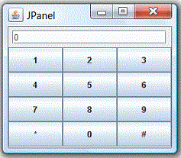
Layout with panel
Panels can be used to organize a group of related components.
For example, the following figure shows a Frame (in BorderLayout) containing two Panels, panelResult in FlowLayout and panelButtons in GridLayout. panelResult is added to the NORTH, and panelButtons is added to the CENTER.

Slide 25
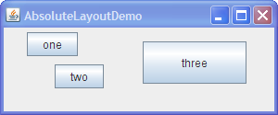
Without a Layout Manager(Absolute Positioning)
If a container holds components whose size is not affected by the container's size or by font, look-and-feel, or language changes, then absolute positioning might make sense.

Slide 26
Without a Layout Manager
Creating a container without a layout manager involves the following steps.
Set the container's layout manager to null by calling setLayout(null).
Call the Component class's setbounds method for each of the container's children.
Call the Component class's repaint method.
Note: if you use WYSWYG GUI Builder, such as, windowbuilder in Eclipse, theses code are generated automatically.

Slide 27
Event-Driven programming
Java adopts the so-called "Event-Driven" (or "Event-Delegation") programming model for event-handling.
In event-driven programming, a piece of event-handling codes is executed (or called back by the graphics subsystem) when an event has been fired in response to an user input (such as clicking a mouse button or hitting the ENTER key).
This is unlike the procedural model, where codes are executed in a sequential manner.

Slide 28
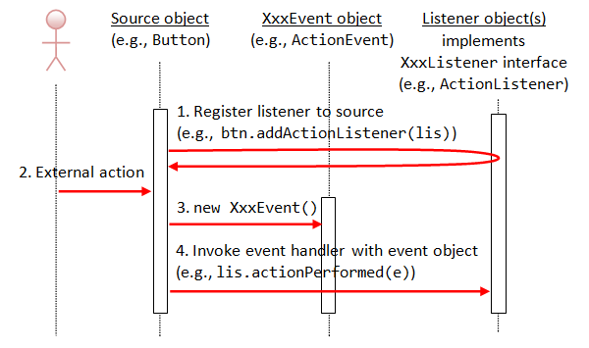
Event-Handling
Three objects are involved in the event-handling: a source, listener(s) and an event object.

Slide 29
Event-Handling
The source object (such as Button and Textfield) interacts with the user.
Upon triggered, it creates an event object.
This event object will be messaged to all the registered listener object(s), and an appropriate event-handler method of the listener(s) is called-back to provide the response.
In other words, triggering a source fires an event to all its listener(s), and invoke an appropriate handler of the listener(s).

Slide 30
Event source objects
The event source objects includes the GUI Container and components.(e.g. JButton and JTextfield, etc.)

Slide 31
Event trigger
The trigger may be user, who may interact with the software by way of, for example, keystrokes on the keyboard.
Another trigger may be hardware devices such as timer.
Software can also trigger its own set of events into the event loop, e.g. to communicate the completion of a task.

Slide 32
Event
Swing use the XXXEvent classes which belong to AWT (in package java.awt.event).
For example, clicking an Button fires an ActionEvent, mouse-click fires MouseEvent, key-type fires KeyEvent, etc.
Swing introduces a few new event classes (in package javax.swing.event) but they are not frequently used.

Slide 33
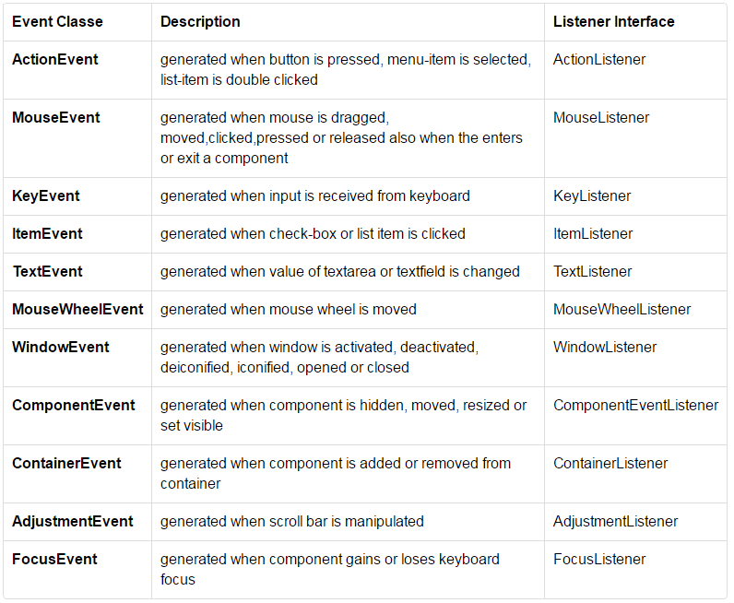
Event

Slide 34
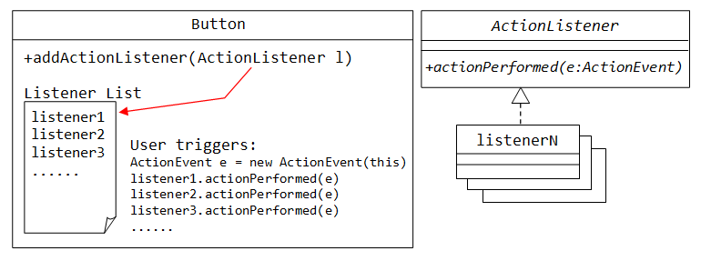
Event Listener
We need to implement XXXListener interfaces to response to these events appropriately.
The source object then registers listener object via the addXxxListener() method.

Slide 35
Event Listener
In general, we use anonymous inner class to implement the event listener interfaces.
Sometimes, we register two or more listeners to the same event source.
When an event are fired, more than one listeners can be revoked to response the event.

Slide 36
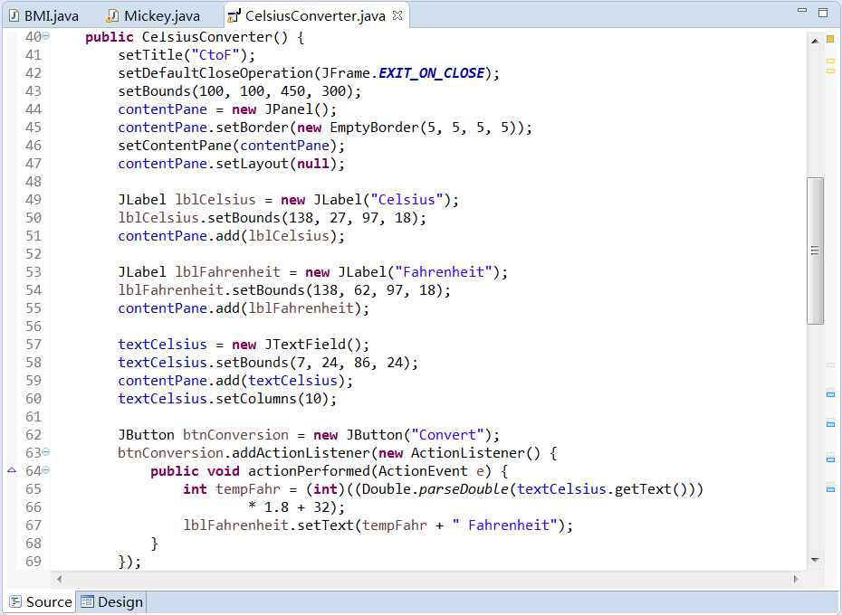
Event Listener

Slide 37
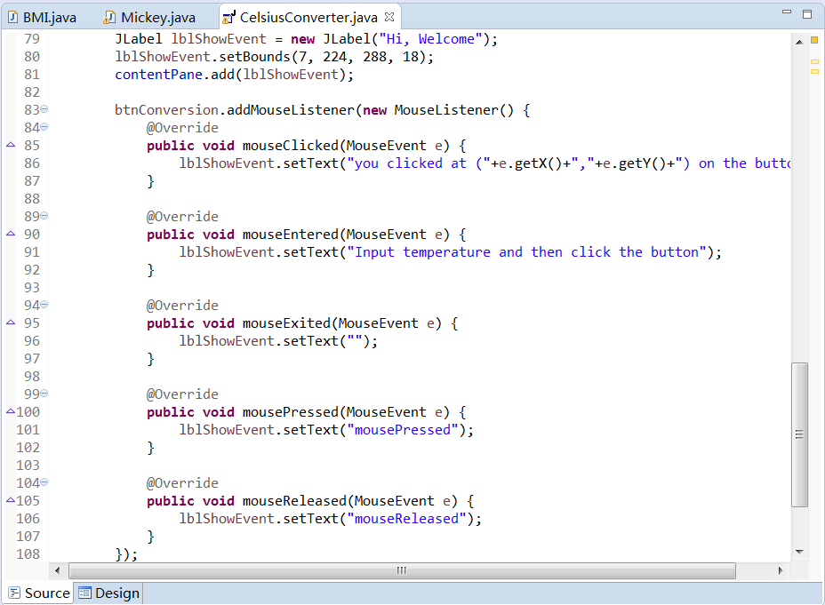
Event Listener

Slide 38
Event adapter
if necessary, Events require you to implement every methods of the listener interfaces.
The adapter classes can help reduce the amount of code you must write when your application needs only a small subset of all interface methods.
Each adapter class fully implements its associated interface (or interfaces).
Except for ActionListener, each listener has a adapter class.
MouseAdapter, MouseMotionAdapter, KeyAdapter, FocusAdapter are available for MouseListener, MouseMotionListener, KeyListener, and FocusListener, respectively.
Notes:
https://blogs.oracle.com/CoreJavaTechTips/entry/listeners_vs_adapters

Slide 39
Dialog
If user did not input the Celsius temperature, there will be an error, how to alert user to avoid this error.
JOptionPane makes it easy to pop up a standard dialog box that prompts users for a value or informs them of something.
Method Name | Description
showConfirmDialog | Asks a confirming question, like yes/no/cancel.
showInputDialog | Prompt for some input.
showMessageDialog | Tell the user about something that has happened.
showOptionDialog | The Grand Unification of the above three.
http://docs.oracle.com/javase/7/docs/api/javax/swing/JOptionPane.html
Notes:
http://docs.oracle.com/javase/tutorial/uiswing/components/dialog.html

Slide 40
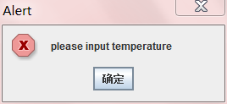
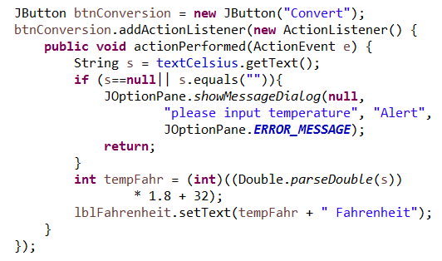
Dialog

Slide 41
Menu
As mentioned above, a JFrame has a title bar, an optional menu bar and the content-pane.
To create a menu-bar, construct a JMenuBar. The menu-bar is set via the JFrame's setJMenuBar() method.
A menu-bar (JMenuBar) contains menu (JMenu). A menu contains menu-item (JMenuItem). You can use the add() method of the components to assemble the menu bar.
Similar to Jbutton, you can response the ActionEvent via the JMenuItem’s addActionListener() method.

Slide 42
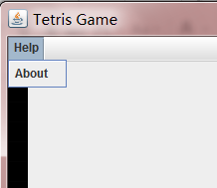
Menu
…
JMenuBar menu = new JMenuBar();
JMenu helpMenu = new JMenu("Help");
JMenuItem aboutitem = new JMenuItem("About ");
aboutitem.addActionListener(new ActionListener() {
public void actionPerformed(ActionEvent e) {
//do something
}
});
helpMenu.add(aboutitem);
menu.add(helpMenu);
frame.setJMenuBar(menu);
…

Slide 43
Demo

Slide 44
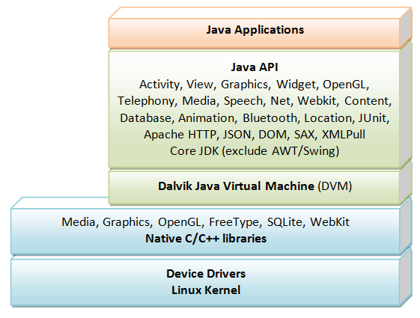

Android UI
Android is an Operating System for mobile devices developed by Google, which is built upon Linux kernel.

Slide 45
Android UI
Android supports many core JDK packages, except graphics packages AWT and Swing. It provides its own 2D graphics supports, via views and widgets. It supports 3D graphics via OpenGL ES.

Slide 46
Reading materials
http://www3.ntu.edu.sg/home/ehchua/programming/android/Android_BasicsUI.html
http://developer.android.com,

Slide 47
BMI Statistics
How to show the different GUIs?
How to show the students ?
How to input the information of a student?
How to delete a student?
How to modify a student?

Slide 48
How to show the different GUIs?
public class GUIBMI extends JFrame {
…
JMenuBar menu = new JMenuBar();
JMenu opMenu = new JMenu("Operations");
JMenuItem listitem = new JMenuItem("List students");
listitem.addActionListener(new ActionListener() {
public void actionPerformed(ActionEvent e) {
showStudetns();
}
});
opMenu.add(listitem);
…
private void showStudetns(){…}
…
}

Slide 49
private void showStudetns(){
this.setContentPane(new resultPanel());
setVisible(true);
}

Slide 50
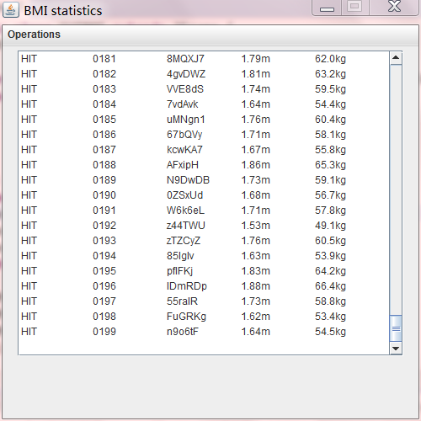
Showing the students
JTextArea
JScrollPane

Slide 51
Showing the students
class resultPanel extends JPanel{
public resultPanel() {
JTextArea ta= new JTextArea("",20,40);
ArrayList<Student> alst= Student.genTestStudents();
StringBuffer sb = new StringBuffer();
for(Student st: alst){
sb.append(st.toString()).append("\n");
}
ta.setText(sb.toString());
ta.setEditable(false);
JScrollPane sp=new JScrollPane(ta);
sp.setBounds(5, 5, 500, 300);
sp.setVerticalScrollBarPolicy(JScrollPane.VERTICAL_SCROLLBAR_AS_NEEDED);
this.add(sp);
}
}

Slide 52


